Slide 1

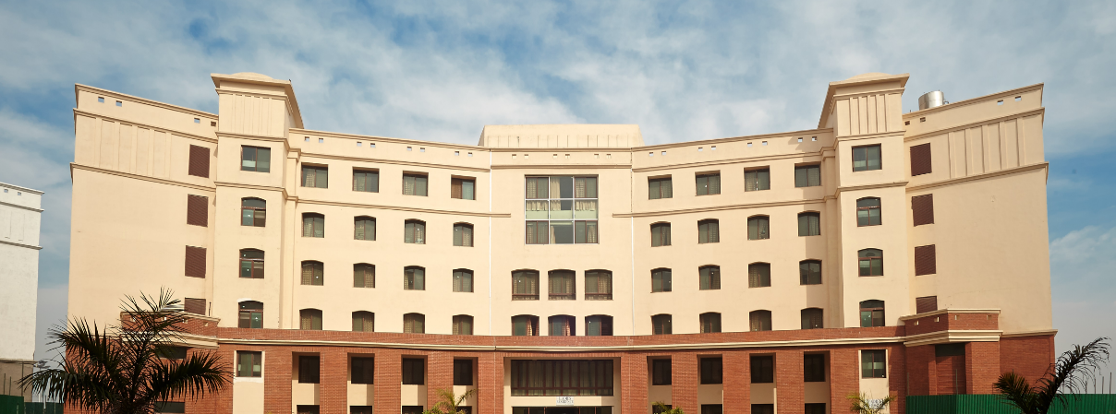
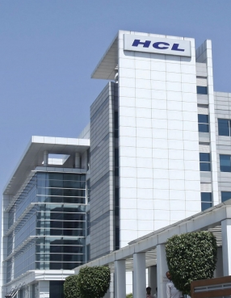



Modern Software Development Practices
Project Management Module
SESSION 3

Slide 2
Agenda
Context setting
Quality Management
Risk Management
Project Monitoring and Control

Slide 3
Recap of Previous Session

Slide 4
Project Management Phases
Process Groups
Initiation
Closing
Planning
Executing
Monitoring & Control
Activities
Define a new project or new phase, identify stakeholders, and obtain authorization “Authorize the Work” | Develop an integrated project management plan to attain project objectives “Plan the Work” | Complete the work and satisfy project Objectives “Work the Plan | Track and review project progress and performance; manage variance and change “Control the Plan | Finalize all activities and formally close the project or phase “End the Work”
• Project Charter • Stakeholder Register | •Project Mgt. Plans & Related Documents - Scope - Requirements Schedule Cost Quality Human Resources Communication Risk Procurement Change Stakeholders | • Project Deliverables • Work Performance Data • Team Performance Assessments • Project Communications (e.g. status reports) • Selected Suppliers & Agreements • Change Requests • Issue Log | • Change Logs • Approved Change Requests • Work Performance Information • Schedule Forecasts • Cost Forecasts • Updates to Project Plan • Quality Control Measurements • Verified Deliverable • Accepted Deliverable | • Final Product, Service, or Result (i.e. purpose of project) • Closed Procurement (e.g. formal signature of acceptance)
Key Outputs

Slide 5

Quality Management
Quality Management is the process to ensure that the project will satisfy the needs of the beneficiaries. Quality is defined as a commitment to deliver the project outputs and meet the expectations of the beneficiaries which means that quality is ultimately defined by the beneficiary.

Slide 6

Quality Management
Project Quality Management ensures the project will satisfy NEEDS for which it was undertaken.
Plan Quality
Perform Quality Assurance
Perform Quality control
What is Quality ?
Conformance to specifications
Fitness for use.

Slide 7
Quality Management
There are four steps in Quality management:
Quality Definition
Quality Assurance
Quality Control
Quality improvements

Slide 8
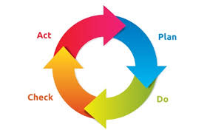
Quality Management
The most popular tool used to determine quality assurance is the Shewhart Cycle.
This cycle for quality assurance consists of four steps: Plan, Do, Check and Act. These steps are commonly abbreviated as PDCA.

Slide 9
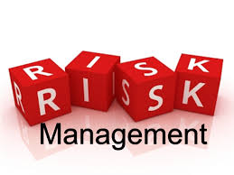
Risk Management
Risk Management includes the processes concerned with identifying, analyzing and responding to Project risks. Risk in a project is defined as something that may happen and if it does, it will have an adverse impact on the project.

Slide 10
Project Risk
“Project risk is an uncertain event or condition that, if it occurs, has a positive or negative effect on a project objective”
“A combination of the probability of a defined threat or opportunity (Likelihood) and the magnitude of the consequences of the occurrence (Impact) defines a Risk Index”

Slide 11
Risk Impact
Threat → Scope → Poor Quality Product
Threat → Schedule → Late Delivery
Threat → Cost → Overspend
In addition there are other threats that must be managed

Slide 12
Risk Management Process
Identify Risks
Assess likelihood and impact
Risk Evaluation
Risk Plan and Improvements

Slide 13
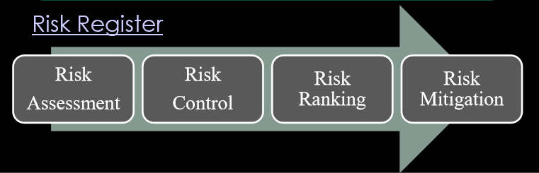
Risk Management Process
Risk Planning
Risk Monitoring and Response
Rank risks and prioritise
Define risk management approach & actions
Implement actions
Monitor & review

Slide 14
Project monitoring
Regular reviews of progress against schedule using WBS as basis (Plan against Baseline)
Regular review of actual costs
Regular review of resource loading
Regular progress meetings with project team
Regular meetings with contractors
Production of periodic progress reports
Risk reviews
Inspections/ audits

Slide 15
Project monitoring and control
Monitoring – collecting, recording and reporting information concerning project performance that project manager and others wish to know.
Controlling – uses data from monitor activity to bring actual performance to planned performance

Slide 16
Project monitoring and control
Why do we monitor?
What do we monitor?
When do we monitor?
How do we monitor?

Slide 17
Why do we monitor?
Simply because we know that things don’t always go according to plan (no matter how much we prepare)
To detect and react appropriately to deviations and changes to plan.

Slide 18
What do we Monitor?
Human Resources
Space
Machines
Materials
Money
Time
Tasks
Quality

Slide 19
What do we Monitor?
Inputs
Time
Money
Resources
Tasks
Quality
Outputs
Progress
Cost
Job Start
Design changes
Variation

Slide 20
When do we Monitor?
End of Project
Continuously
Regularly
Logically
While there is still time to react
As soon as possible
At task completion
At pre-planned decision points (Milestones)

Slide 21
How do we Monitor?
Through meetings with client, parties involved in project
For schedule – Update PERT charts, Gantt charts
Milestones
Reports
Test and inspections
Delivery or staggered delivery

Slide 22
Meetings – Some monitoring issues
What problems do you have and what is being done to correct them?
What problems do you anticipate in future?
Do you need any resources you do not yet have?
Do you need information you do not have yet?
Do you know anything that will give you schedule difficulties?
Any possibilities your task will finish early/late?
Will your task be completed under/over/on budget.

Slide 23
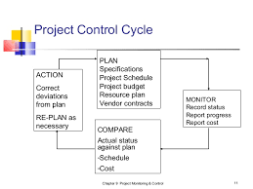
Project Control Cycle

Slide 24
Project Control
Control – process and activities needed to correct deviations from plan
Control the triple constraints
Time (schedule)
Cost (budget, expenses etc)
Performance (specifications, testing, results, etc)

Slide 25
Websites to look at as Project Management
https://www.pmi.org – Project Management
https://www.cebglobal.com/ -(PMO Leadership Council)
https://www.projectmanagement.com/- Webnairs
https://www.capterra.com/project-management-software/– Project Management Tools
https://www.slideshare.net/ostephens/project-management-tools-2014562- Project Management Tools
https://www.pmbypm.com/difference-project-program-and-portfolio/
https://www.youtube.com/watch?v=9LSnINglkQA
https://www.youtube.com/watch?v=6Or_9IRQHi4

Slide 26
Thank You

